Slide 1

Mini Project
On
Tic Toc Toe Game
Submitted By
LAKSHMI
ASHMIT MISHRA
VIBHAV TIWARI

Slide 2
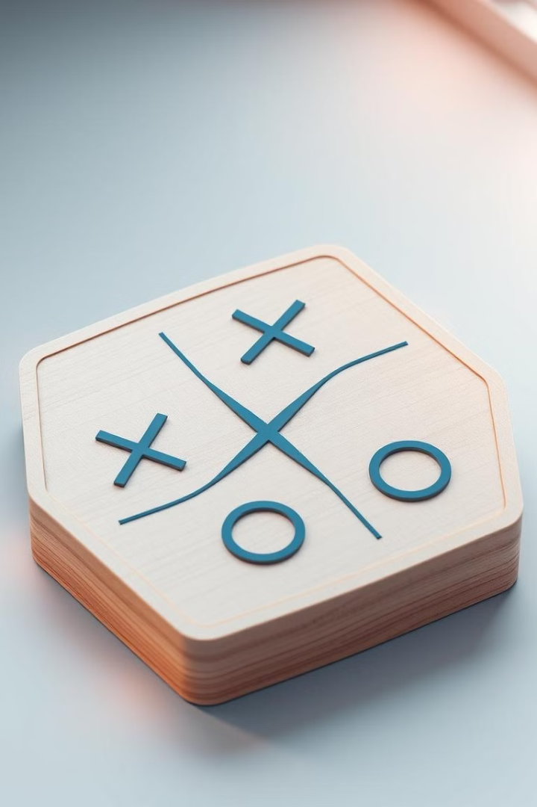
Tic Tac Toe Game in Python
Welcome to this presentation on developing a Tic Tac Toe game in Python. We'll explore the steps involved, from designing the game board to implementing the logic for checking winning conditions. We'll also delve into incorporating AI players and enhancing the user interface.

Slide 3
Introduction to Tic Tac Toe
Classic Game
Strategic Thinking
Tic Tac Toe is a simple yet engaging game. Two players take turns placing their marks (X or O) on a 3x3 grid, aiming to get three in a row.
The game requires strategic thinking, as players need to anticipate their opponent's moves and plan their own to secure a winning position.

Slide 4
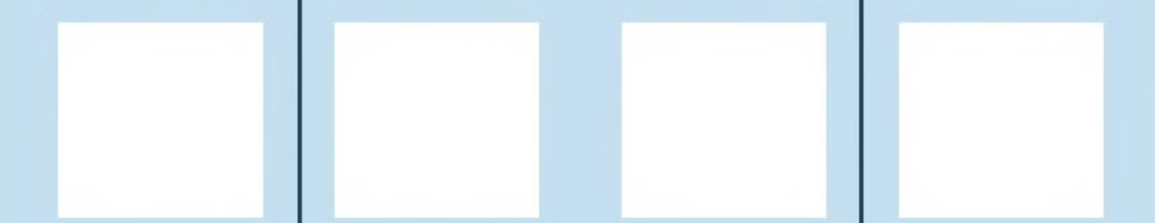
Designing the Game Board
1
Grid Structure
2
Initial State
3
Visual Representation
We'll represent the game board as a 2D list, with each element representing a square on the board. This allows us to easily access and manipulate the board data.
Initially, all squares are empty. We can use a specific character, like " " (empty space), to represent an empty square.
We can display the board visually for the user. We'll use print statements to display the grid and the current state of the board.

Slide 5

Defining Player Moves
Player Turns
Validating Moves
Updating Board
We'll alternate turns between Player X and Player O. Each player will input their desired move by specifying the number of the square.
We need to ensure that players only select valid squares. We'll validate the user input to check if the chosen square is empty and within the board boundaries.
Once a valid move is made, we'll update the corresponding square on the board with the player's symbol (X or O).

Slide 6
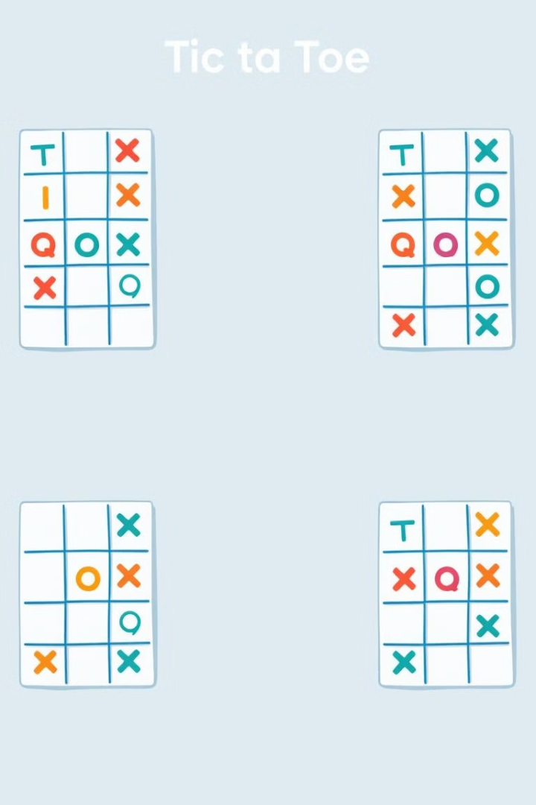
Implementing Game Logic
1
Input Handling
The game logic will handle user input, validating moves and updating the board accordingly.
2
Winning Condition
The logic will check for winning conditions after each move, determining if any player has achieved three in a row.
3
Tie Game
If all squares are filled and no player has won, the game will declare a tie.

Slide 7
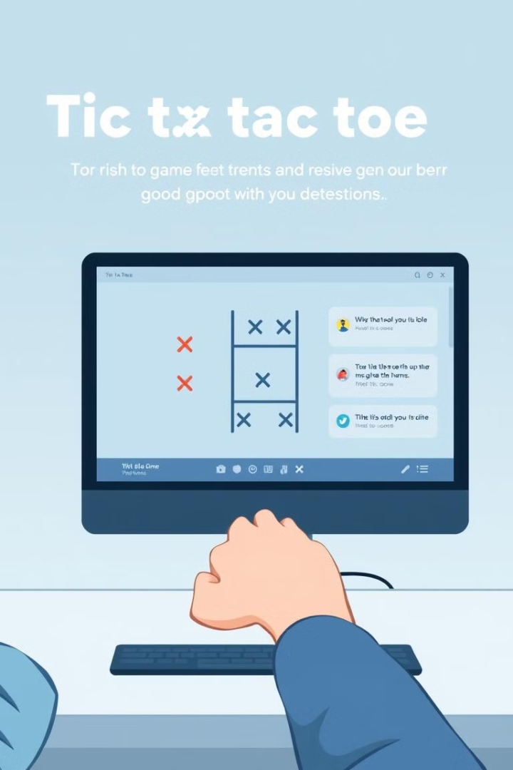



Handling User Input
Input Mechanism
We'll use the input() function to get user input from the console. The user will enter a number corresponding to their desired square.
Input Validation
We'll validate the input to ensure it's a valid number within the board range and that the chosen square is empty.
Error Handling
If the input is invalid, we'll provide an error message to the user and prompt them to re-enter a valid move.

Slide 8
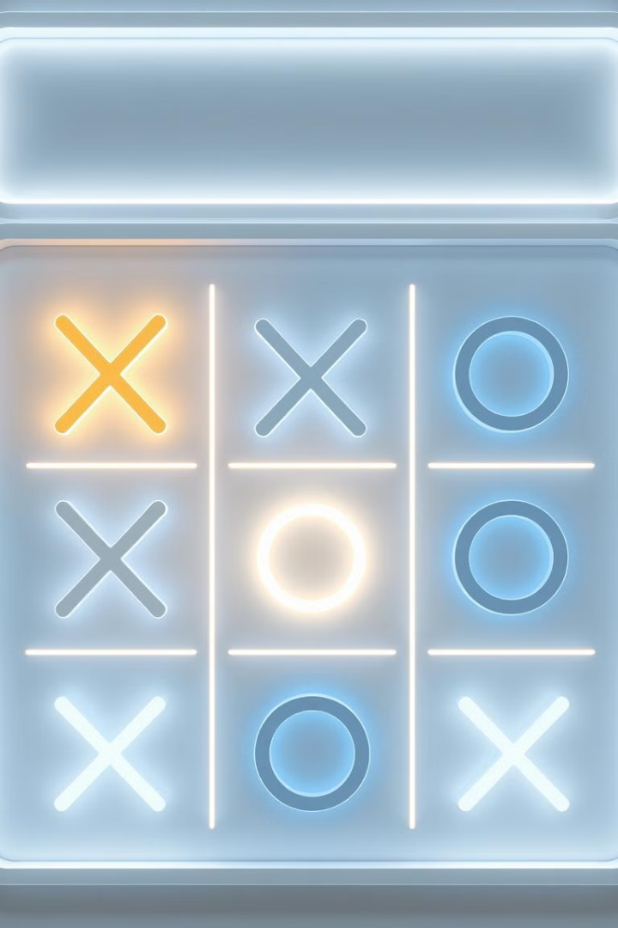
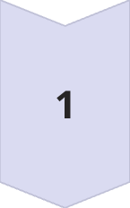
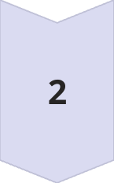
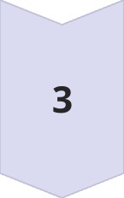
Checking for Winning Conditions
Rows, Columns, and Diagonals
We'll check each row, column, and diagonal of the board to see if any player has three in a row.
Checking Logic
We'll use loops and conditional statements to compare the symbols in each row, column, and diagonal.
Declaration of Winner
If a winning condition is met, the game will declare the winner and display a congratulatory message.

Slide 9
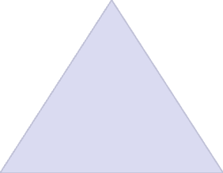
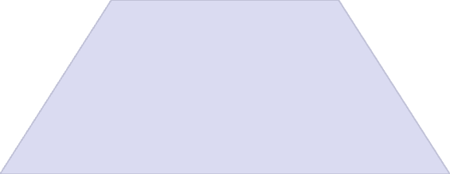
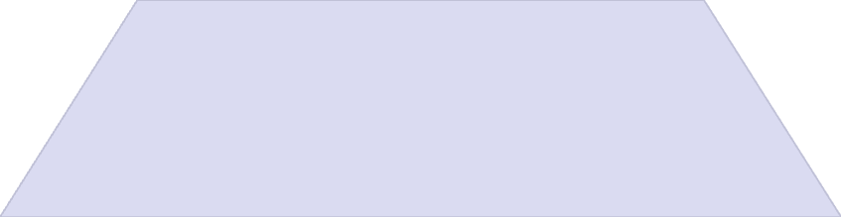
Incorporating AI Players
AI Logic
1
The AI player will have a strategy to select squares. This could be a simple strategy like selecting a random square.
Advanced AI
2
More advanced AI algorithms can consider potential moves, anticipate opponent moves, and aim to achieve the best outcome.
Human vs. AI
3
Players can now choose to play against the AI player, adding a new dimension to the game.

Slide 10
Enhancing the User Interface
Graphical Interface
1
We can create a more engaging experience by using a graphical interface. Libraries like Tkinter can help create a window-based interface.
Visual Elements
2
We'll incorporate visuals like colored squares, clickable buttons, and animations to improve the user experience.
Sound Effects
3
Sound effects can add excitement to the game. We can use libraries to play sounds when a player makes a move or wins.

Slide 11

Conclusion and Next Steps
1
2
3
Basic Game
AI Improvements
Customization
We have now developed a functional Tic Tac Toe game in Python.
Explore advanced AI strategies to create a more challenging AI opponent.
Add customization options, such as changing the game board size, colors, and symbols.

